Slide 1
EECS 2500 Linear Data Structures
Lecture 02
Chapter 01 – Getting Organized, Part 1
Fall 2016
Dr. Larry G. Thomas – University of Toledo/LCCC

Slide 2
Last Time
Course introduction
Material in syllabus
Goals for this semester
Tentative schedule / important dates
Introduction to Software Engineering
Why it’s important that your software isn’t just “thrown together”

Slide 3
Getting Organized
Chapter 1

Slide 4
Chapter 1 Outline
1.1 – Software Engineering
1.2 – Object Orientation
1.3 – Classes, Objects, and Applications
1.4 – Organizing Classes
1.5 – Data Structures
1.6 – Basic Structuring Mechanisms
1.7 – Comparing Algorithms: Big-O Analysis

Slide 5
Software Engineering
Section 1.1

Slide 6
§1.1: Software Engineering
“The field devoted to the specification, design, production, and maintenance of computer programs that are developed to meet specifications on time and within cost estimates, using tools that help to manage the size and complexity of the resulting software products”
- Textbook’s definition
See the first paragraph at http://en.wikipedia.org/wiki/Software_engineering

Slide 7
Software Engineering
Includes such activities as:
Cost estimation (and tracking)
Documentation (at all stages; not just the user’s manual at the end)
Team organization and management
Use CASE (Computer-Aided Software Engineering) tools
Project management
Planning and tracking project milestones
Dealing with issues when they (inevitably) arise;
Managing resources (time, money, people, hardware)

Slide 8
Software Engineering
Software Development Life Cycle (SDLC):
Problem analysis – what’s the nature of the problem?
Requirements elicitation – what must the program do?
From the customer’s standpoint
Requirements specification – what must it do (again)
From the developer’s standpoint
High- and low-level design – How will the requirements be met by the program?
High-level design is the “big picture”; low-level is how the little pieces work together to realize the high-level design

Slide 9
Software Engineering
Software Development Life Cycle (cont’d):
Implementation – actually writing the code
Testing and verification
Sometimes called Validation & Verification (V&V)
Does what we wrote do what we designed it to do?
Is what we wrote what the customer said they wanted?
Is what we wrote what the customer really needed?
Delivery – Turning the program over to the customer
Operation – Actually using the program
Maintenance – making changes to fix faults in the software or to add / modify the program’s functionality

Slide 10
Software Life Cycles
Of all of the activities in the life of software:
Problem analysis
Requirements elicitation
Requirements specification
High- and low-level design
Implementation
Testing and verification
Delivery
Operation
Maintenance
Where are most of the resources (man-hours and, because “time is money”, dollars) spent for large applications?

Slide 11
Software Life Cycles
Of all of the activities in the life of software:
Problem analysis
Requirements elicitation
Requirements specification
High- and low-level design
Implementation
Testing and verification
Delivery
Operation
Maintenance ← most of the work is here!
Where are most of the resources (man-hours and, because “time is money”, dollars) spent for large applications?

Slide 12
Software Engineering
There are multiple software development lifecycle models.
We will briefly examine:
The waterfall model
The spiral model
Agile development
The Unified Process
Sometimes called the Unified Method, or
RUP – the Rational Unified Process

Slide 13
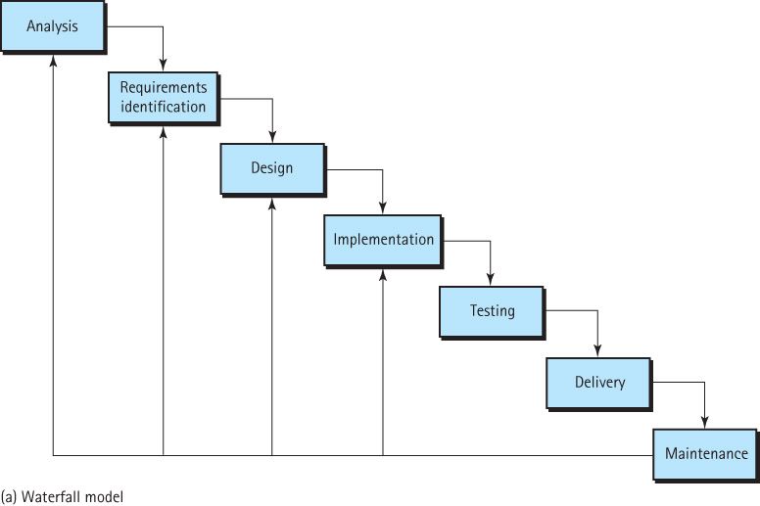
Waterfall Life-Cycle Model

Slide 14
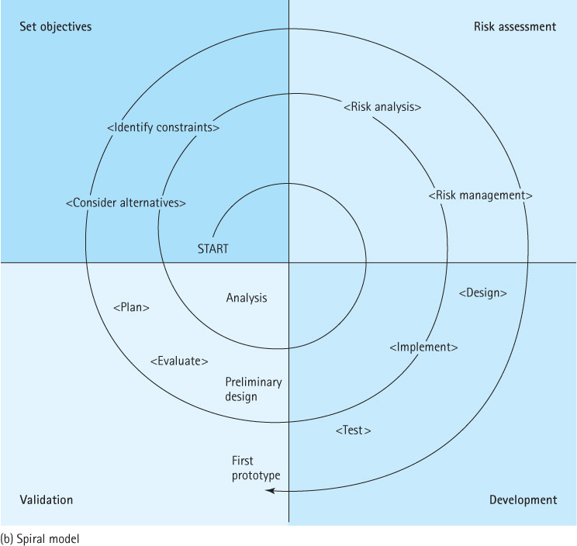
Spiral Life-Cycle Model

Slide 15
Agile Methods
Rather than spending too much effort on a cumbersome “process”, why not be more agile by working in small teams, better able to respond to changes?
Formal requirements elicitation and analysis is replaced by having the customer as part of the development team
Code is developed and tested by small groups (usually pairs of programmers)
Written and delivered incrementally

Slide 16
Agile Manifesto
We are uncovering better ways of developing software by doing it and helping others do it. Through this work we have come to value:
Individuals and interactions over processes and tools
Working software over comprehensive documentation
Customer collaboration over contract negotiation
Responding to change over following a plan
That is, while there is value in the items on the right, we value the items on the left even more.

Slide 17
The Unified Process
In the 1990’s, software engineering, as a field, was in upheaval, with several competing strategies.
Booch, Jacobsen, and Rumbaugh had popular, competing approaches that had seen excellent results, and there was considerable overlap between them.
They resolved their differences and created the Unified Process in the late 1990’s

Slide 18
The Unified Process
Unification of three somewhat overlapping models
Driven by “use cases” – how “users” (people and/or other systems, sometimes called “actors” in “roles”) will interact with the system
Architecture-centric – takes care of the high-level to low-level design. The system is designed from the top down, successively decomposing into smaller pieces.
Iterative and Incremental – Waterfall model tries to develop all of the documentation at one level before moving to the next; UM iterates, adding a little each iteration

Slide 19
The Unified Process
The Unified Process has five workflows (requirements, analysis, design, build, test) that repeat within four phases (inception, elaboration, construction, transition).
It is iterative and incremental
It relies heavily on UML diagrams, like what we have already seen (UML Class Diagrams), and will continue to use
But the Unified Process has LOTS of other kinds of diagrams!

Slide 20
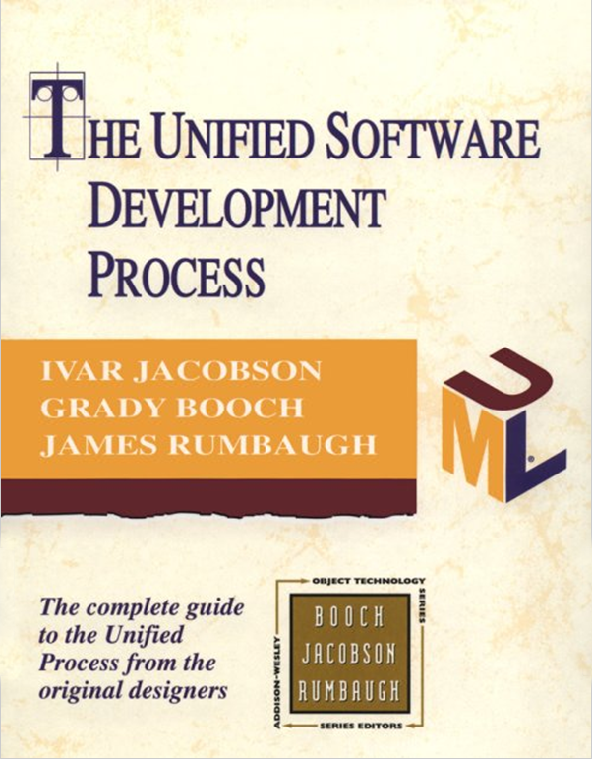
The Unified Process
For more information on the UP, see the seminal book on the subject: The Unified Software Development Process, by Jacobsen, Booch, and Rumbaugh (1999). ISBN: 0201571692
Available used from LOTS of places for ≤ $4.00 (with shipping). Check BigWords.com

Slide 21
Some Goals of Quality Software
Regardless of the lifecycle model, any piece of software we develop should…
…work (correctly)
… be able to be modified without excessive time or effort (“be maintainable”)
…be reusable
…be completed on-scope, on-time, and within budget
Scope, time, and budget are the three axes of project management, just as the 5 C’s (color, cut, clarity, carats, and cost) are for buying a diamond

Slide 22
Object Orientation
Section 1.2

Slide 23
1.2: Object Orientation
Objects Represent
Information: Objects have attributes / values (data)
Behavior: Objects have responsibilities (methods)
Objects can represent “real-world” entities such as bank accounts
Objects are self-contained and therefore easy to implement, modify, and test for correctness
Object-oriented classes, when designed properly, are very easy to reuse

Slide 24
Classes, Objects, and Applications
Section 1.3

Slide 25
1.3: Classes, Objects, & Applications
An object is an instantiation of a class
Alternately, a class defines the structure and behavior of its objects.
A class definition includes variables (data) and methods (actions) that determine the behavior of an object.
Example: the Date class (next slides)

Slide 26
Date Class (1)
// ------------------------------------------------------
// Date.java by Dale/Joyce/Weems/Kiel/Thomas Chapt 01
//
// Supports date objects having year, month, and day attributes
public class Date
{
protected int year;
protected int month;
protected int day;
public static final int MINYEAR = 1583;
// Constructor
public Date(int newMonth, int newDay, int newYear)
{
month = newMonth;
day = newDay;
year = newYear;
}
<listing continues next slide>

Slide 27
Date Class (2)
// Accessors
public int getYear ()
{
return year;
}
public int getMonth()
{
return month;
}
public int getDay()
{
return day;
}
<listing continues next slide>

Slide 28
Date Class (3)
public int lilian()
// Precond : This date is a valid date AFTER 10/14/1582 AD
// Postcond: None
// Purpose : Returns the Lilian Day Number of this date
//
final int subDays = 578100; // number of calculated days from
// from 01/01/0000 to 10/14/1582
int numDays = year * 365; // add days in whole years
if (month <= 2) // Add days in months this year
numDays += (month-1) * 31;
else
numDays += ((month-1) *31) – ((4 * (month-1) + 27) / 10);
numDays += day; // add days so far THIS month
// add days for leap years
numDays += (year / 4) – (year / 100) + (year / 400);
<listing continues next slide>

Slide 29
Date Class (4)
// special case: it’s leap year, but not 2/29 (leap day) yet
if (month < 3)
if ((year % 4) == 0) numDays--;
if ((year % 100) == 0) numDays++;
if ((year % 400) == 0) numDays--;
// Subtract days up to 10/14/1582
numDays -= subDays;
return numDays;
} // end lilian
// precondition: this Date contains a valid date
// postcondition: none
// purpose: returns this Date as a String.
public String toString()
{
return(month + "/" + day + "/" + year);
} // end toString
} // end class Date

Slide 30
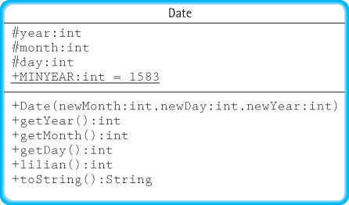
UML Class Diagram for Date Class

Slide 31
UML Class Diagram for Date Class
Conventions in UML Class diagram:
# private (year, month, day)
+ public (MINYEAR, constructor, accessors, mutators, main, toString)
Underlined = Class-level (as opposed to instance-level) variables
Functions, variables, and parameters are followed by a colon (:) and their type

Slide 32
Java’s Access Control Modifiers
 | Within Only the Class | Within Subclasses in the Same Package | Within Subclasses in Other Packages | Everywhere
public | X | X | X | X
protected | X | X | X
package | X | X
private | X

Slide 33
Design of DaysBetween Class
1. Display Instructions
2. Prompt for and read (keyboard) info for first date.
3. Create the date1 object from that info.
4. Prompt for and read (keyboard) info for second date.
5. Create the date1 object from that info.
6. If either or both dates are illegal (pre-Lilian dates)
Print error message.
else
Use the date.lilian() method to get the Lilian numbers of the two dates.
Compute and print the number of days between the dates.

Slide 34
DaysBetween Class (1)
// ------------------------------------------------------
// DaysBetween.java by Dale/Joyce/Weems/Kiel/Thimas Chapt 01
//
// Asks the user to enter two "modern" dates and then
// reports the number of days between the two dates
import java.util.scanner;
public class DaysBetween
{
private static Scanner input = new Scanner(System.in);
<listing continues next slide>

Slide 35
DaysBetween Class (2)
public static void main(String[] args)
{
Date date1, date2; // declare two Date objects
printIntro(); // give the user instructions
date1 = getDateInput();
date2 = getDateInput();
if ((date1.getYear() <= Date.MINYEAR) ||
(date2.getYear() <= Date.MINYEAR))
System.out.println("You entered a 'pre-modern' date.");
else
{
System.out.print("The number of days between ");
System.out.print(date1 + " and " + date2 + " is ");
System.out.print(Math.abs(date1.lilian() – date2.lilian()));
System.out.println();
}
} // end main
<listing continues next slide>

Slide 36
DaysBetween Class (4)
private static Date getDateInput()
// Precondition : Input instantiated
// Postcondition: Three int’s read from input
// Purpose : Returns date created from user’s input
{
int day, month, year;
System.out.print("Enter a date: ");
month = input.nextInt();
day = input.nextInt();
year = input.nextInt();
Date dateIn = new Date(month, day, year);
return dateIn;
} // end getDateInput()
} // end class DaysBetween

Slide 37
DaysBetween In Operation
Sample output:
Enter two ‘modern’ dates: mo day year
Example: For January 15, 2008, enter 1 15 2008
Modern dates occur after 1583.;
Enter a date: 12 10 2007
Enter a date: 1 15 2008
The number of days between 12/10/2007 and 1/15/2008 is 36

Slide 38
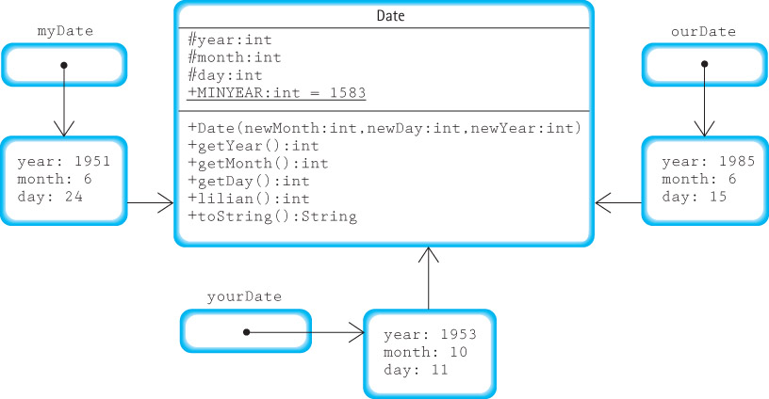
Objects vs Classes
Date myDate = new Date( 6, 24, 1951);
Date yourDate = new Date(10, 11, 1953);
Date ourDate = new Date( 6, 15, 1985);

Slide 39
Applications
An object-oriented application is a set of objects working together, by sending each other messages, to solve a problem.
In object-oriented programming, a key step is identifying the classes that can be used to help solve a problem.

Slide 40
Organizing Classes
Section 1.4

Slide 41
1.4: Organizing Classes
The development of a non-trivial object-oriented application can require hundreds of classes to be created (or previously written and re-used) to help build a system
The task of keeping track of these classes would be impossible without organizational structure
Two of the most important ways of organizing Java classes are:
Inheritance: classes organized in an “is a” hierarchy
Packages: related classes grouped into a single named unit

Slide 42
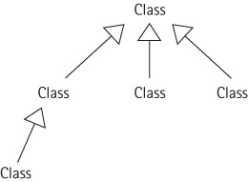
Inheritance
Allows programmers to create a new class that is a specialization of an existing class.
We say that the new class is a subclass of the existing class, which in turn is the superclass of the new class.

Slide 43
Example of Inheritance
public class IncDate extends Date
{
public IncDate(int newMonth, int newDay, int newYear)
{
super(newMonth, newDay, newYear);
}
public void increment()
// Increments this IncDate to represent the next day.
// For example if this = 6/30/2005 then this becomes 7/1/2005.
{
// <increment algorithm goes here>
}
} // end IncDate class

Slide 44
Declaring / Using Date / IncDate Objects
Date myDate = new Date(6, 24, 1951);
IncDate aDate = new IncDate(1, 11, 2001);
System.out.println("mydate day is: " + myDate.getDay());
System.out.println("aDate day is: " + aDate.getDay());
aDate.increment();
System.out.println("the day after is: " + aDate.getDay());

Slide 45
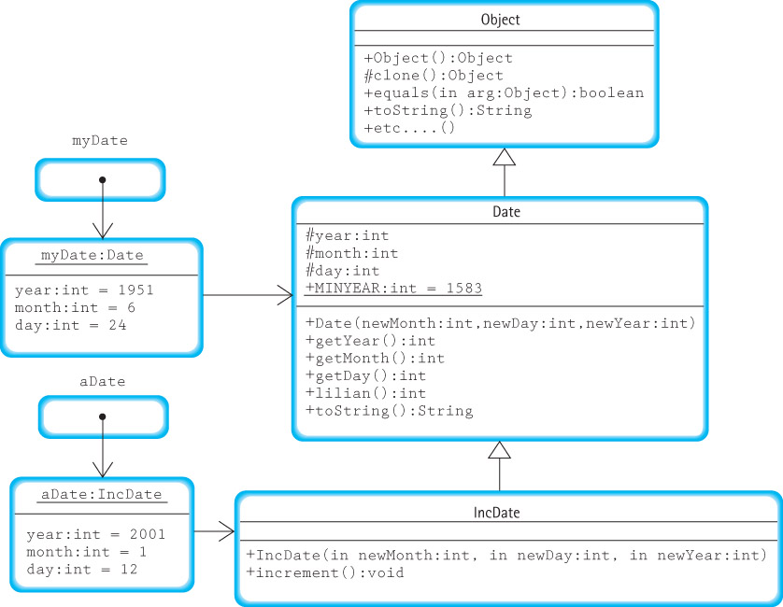
Extended UML Class Diagram

Slide 46
Packages
Java lets us group related classes together into a unit called a package, which provides several advantages.
Packages:
let us organize our files.
can be compiled separately and imported into (re-used by) our programs.
make it easier for programs to use common class files.
help us avoid naming conflicts (two classes can have the same name if they are in different packages).

Slide 47
Using Packages
A Java compilation unit can consist of a file with:
The keyword package followed by an identifier indicating the name of the package:
package someName;
import declarations, to make the contents of other packages available:
import java.util.Scanner;
One or more declarations of classes; exactly one of these classes must be declared public
The classes defined in the file are members of the package.
The imported classes are not members of the package.
The name of the file containing the compilation unit must match the name of the public class within the unit.

Slide 48
Using Packages
Each Java compilation unit resides in its own file.
The Java system identifies the file using a combination of the package name and the name of the public class in the compilation unit.
Java restricts us to having a single public class in a file so that it can use file names to locate all public classes.
Thus, a package with multiple public classes must be implemented with multiple compilation units, each in a separate file.

Slide 49
Using Packages
In order to access the contents of a package from within a program, you must import it into your program:
import packagename.*;
import packagename.Classname;
The Java package rules are defined to work seamlessly with hierarchical file systems:
import ch03.stacks.*;
Import javax.Swing.*;

Slide 50
Data Structures
Section 1.5

Slide 51
1.5: Data Structures
Enough about java itself!
This course if about data structures
We’ve seen a great deal about structuring your programs:
if/then, do/while, for, try/catch blocks
Dividing our solution into packages, classes, and methods
What about the structure of the data itself?
For the most part, we’ve used simple variables or arrays for all of our data.
But wait, there’s more!

Slide 52
Data Structures
The way you view and structure the data that your programs manipulate greatly influences your success.
A language's set of primitive types (Java's are byte, char, short, int, long, float, double, and boolean) are not sufficient, by themselves, for dealing with data that have many parts and complex interrelationships among those parts.
Data structures provide this ability.

Slide 53
? Questions ?
? Any Questions ?

Slide 54
Next Time
Next time, we will finish Chapter 1 (Sections 1.6 and 1.7)

